Slide 1
Tuning a Generative Language Model for the Creation of Customized Chatbots for Public Administrations
Martí Mas Fullana
Josep Suy Franch

Slide 2
Introduction
The project is part of the government's intention to provide more assistance to citizens on social rights issues, thereby improving the current response capacity.
Necessities
Challenges
Have a chat-like tool which citizens can use to easily get up-to-date information and “first-aid” help on social rights benefits.
The tool must use information extracted from the Generalitat’s websites.
Have valid and accredited data sources
Must work in multiple languages
Must act similar to a social worker: be natural (instead of robotic), be welcoming...

Slide 3




Objectives
1
2
3
4
Pick an appropriate LLM model
Integrate RAG technology
Facilitate User-Chatbot interaction
(UI and UX)
Be accessible

Slide 4


Slide 5
Methodology
SCRUM Methdology:
Product Owner: The department of social rights (DSO).
SCRUM Master: Francesc Sans
Development Team:
Benjamí Fuertes (Architect)
Joan Oller (Frontend)
Sergi Martínez (Backend)
Arnau Serra (Tooling)
Oleh Kharenko (Tooling)
Martí Mas (Data Scientist)

Slide 6
Data
Collection (sources):
Stakeholder’s websites.
AI Services (API):
kSocial: Products
tSocial: SNOMEDs
Preparation:
Scraping
Caching

Slide 7
System Architecture

Slide 8
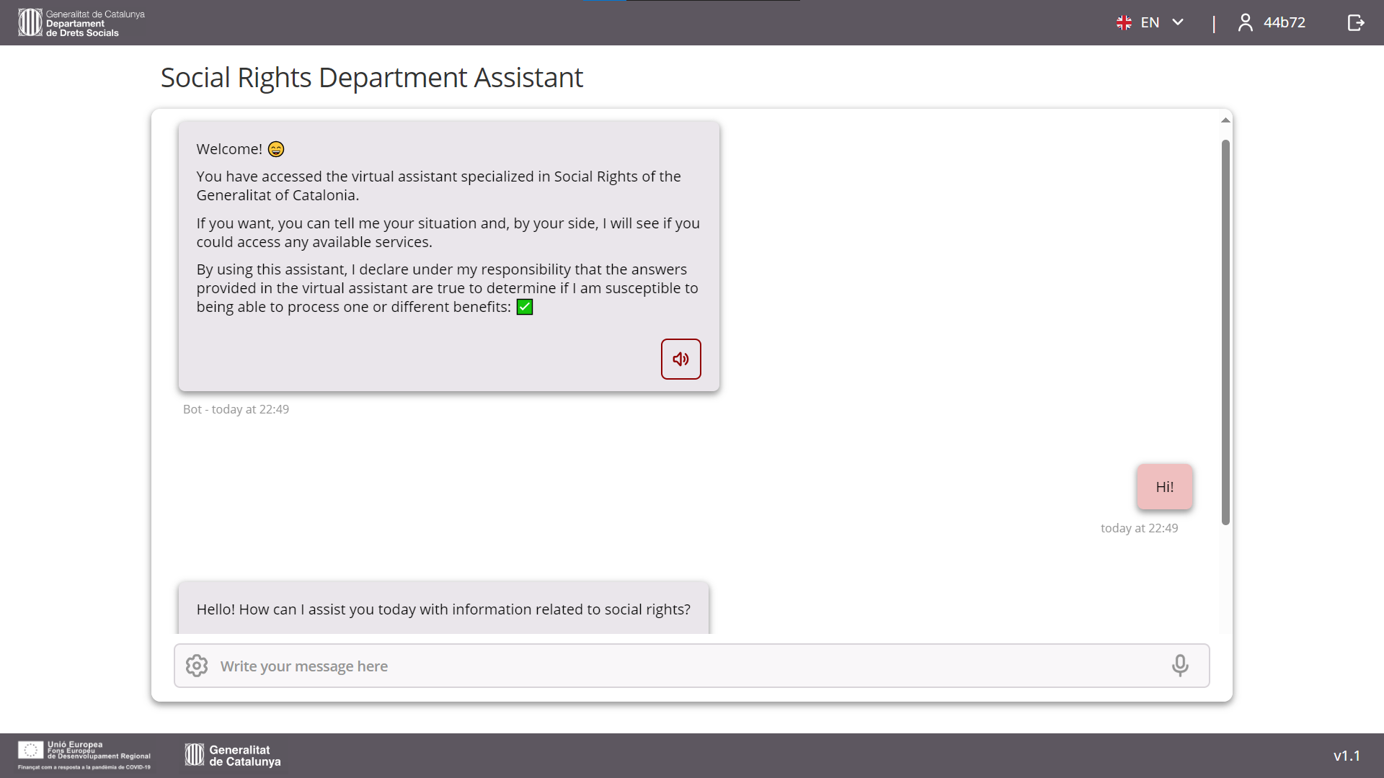
Frontend

Slide 9
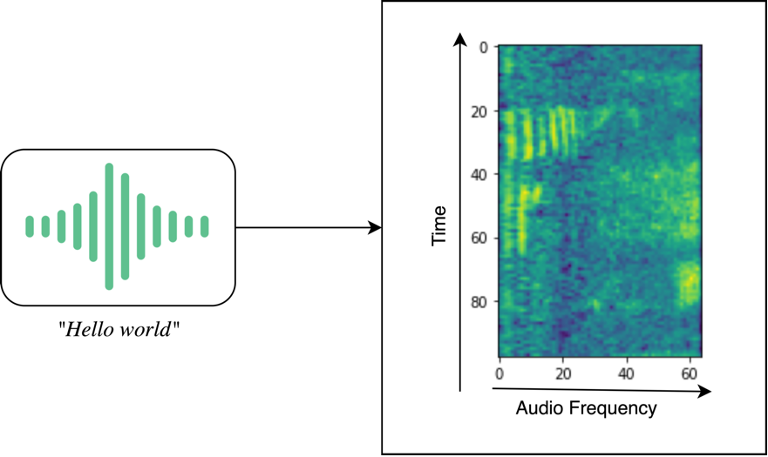
Accessibility: Hotword Detection
Mel spectrogram of the audio “Hello world” (image taken from [Chidhambararajan 2022])

Slide 10
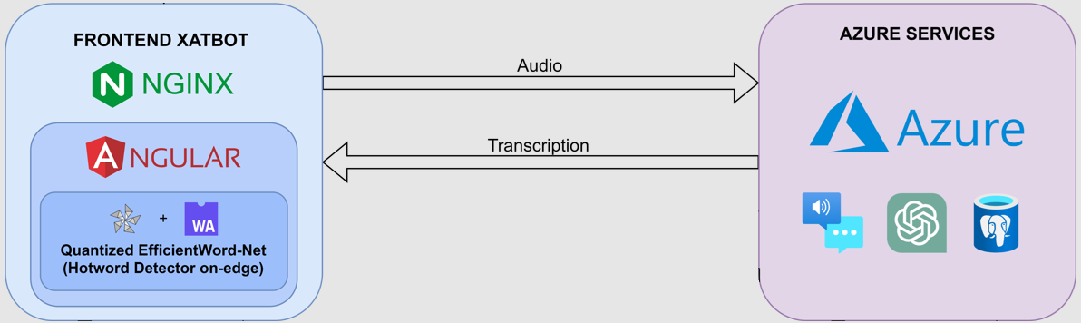
Accessibility: STT & TTS

Slide 11

Data Storing
pgVector Extension
tsVector Extension

Slide 12

GPT Model
GPT-3.5 Turbo
GPT-4
GPT-4o
GPT-4o Mini

Slide 13
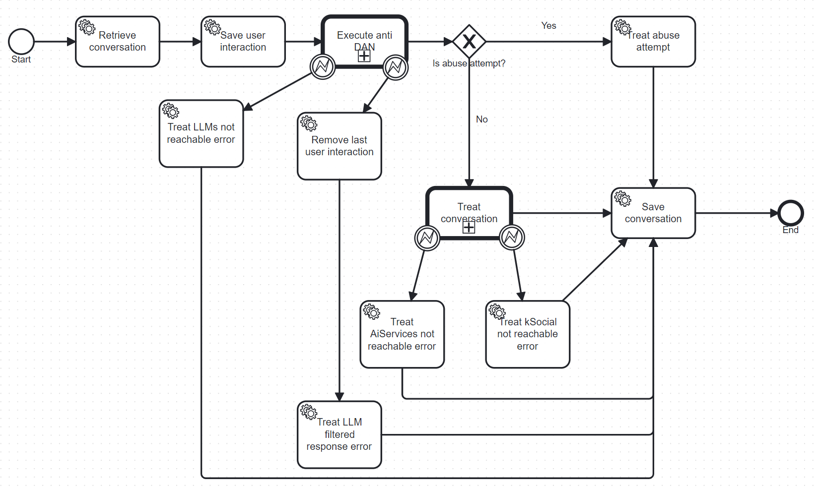
Backend (Springboot & Flowable)

Slide 14
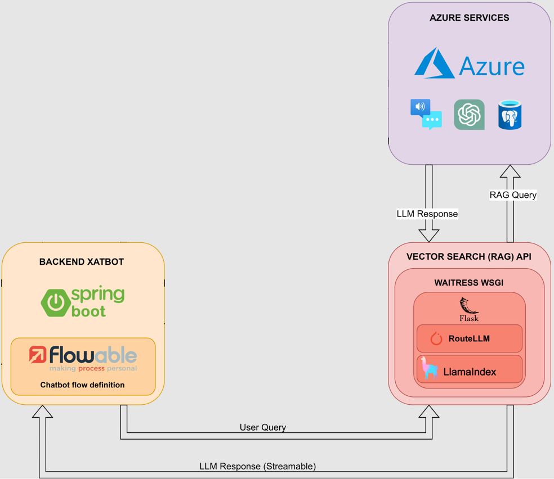
VectorSearchAPI

Slide 15
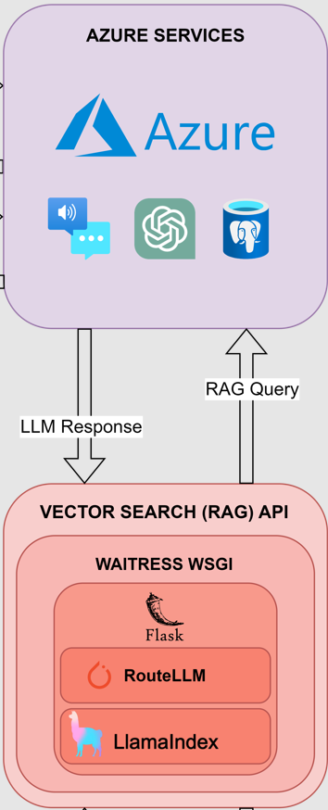
RouteLLM
Cost Reductions
Faster average response time

Slide 16
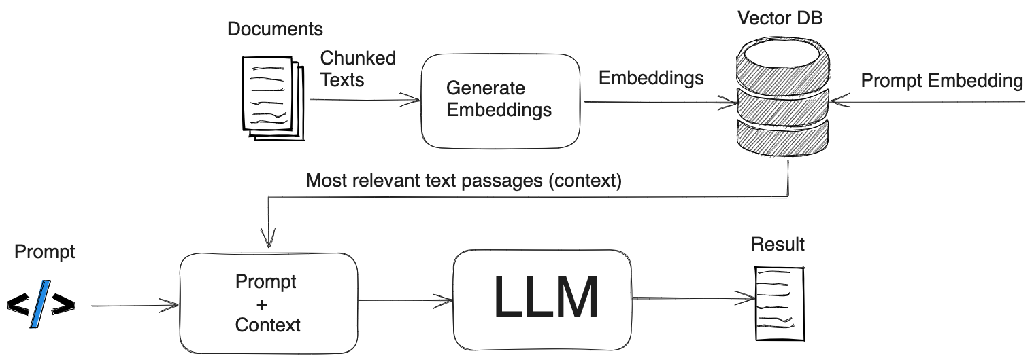
Normal RAG
Image credit: https://safjan.com/understanding-retrieval-augmented-generation-rag-empowering-llms/

Slide 17
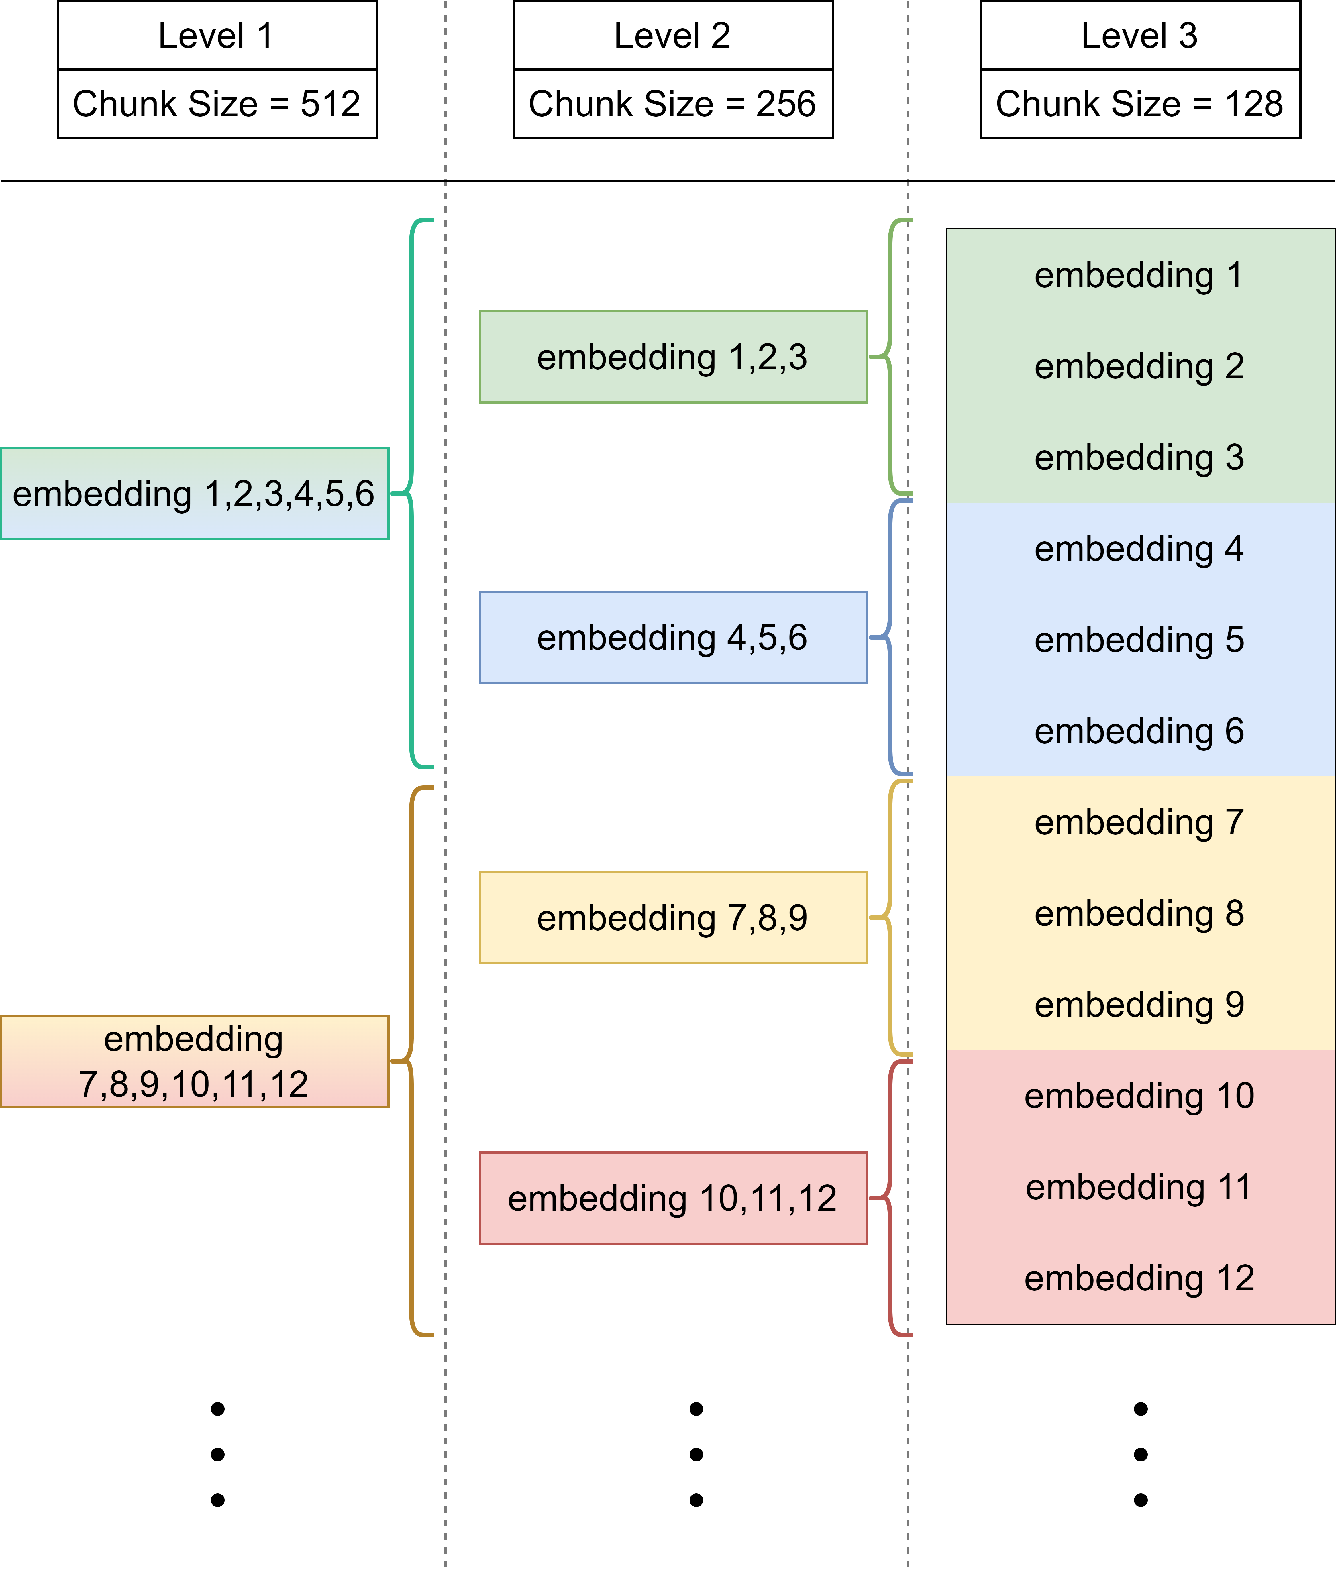
Small To Big Retrieval RAG

Slide 18
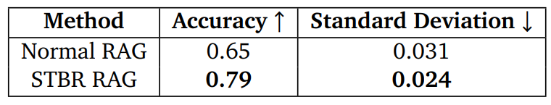
RAG Results

Slide 19
Conclusions & Future Work

Slide 20
Contributions to Open Source
EfficientWord-Net
RouteLLM

Slide 21
Thanks!

